Slide 1
Comparative​ ​study​ ​for​ ​usage of​ ​PI , Pd​ ​and​ ​Modern​ ​predictive controllers​ ​ for​ ​trajectory tracking​ ​of​ ​a​ ​wheeled​ ​robot
CONTROL SYSTEMS DESIGN FOR ROBOTS AND TELEROBOTS
ELEC-848
Student name : Moemen Yasser Moemen
Student number:20078937
Submitted to : Professor Keyvan Hashtrudi Zaad

Slide 2
Presentation outline
Tasks
Problem objectives
Techniques
Simulation details and results
Comparison of result
Discussion and challenges
Conclusion and future work

Slide 3
Project main tasks
Robot Modelling
Understanding PI and PD controller design and tuning
Understanding basics of Model predictive control (MPC) theory
Implementing both controllers in MATLAB

Slide 4
Problem objective
Solving trajectory tracking problem using wheeled mobile robot using two control strategies
PI , PD and MPC controllers are investigated
Results of there controllers are compared to select the most suitable controller

Slide 5
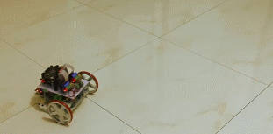
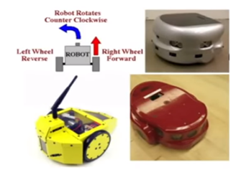
Techniques : Robot Modelling
Differential drive mobile robot

Slide 6
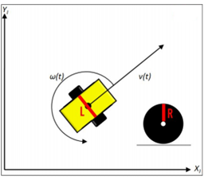
Techniques : Robot Modelling
Differential drive mobile robot
Modelling this robot take into consideration some parameters
- Parameter (1) : The wheel base, meaning how far away are the wheels from each other , In this report wheel base will be called (L).
- Parameter (2): The radius of the wheel, meaning how big are the wheels, Wheel radius will be capital R.

Slide 7
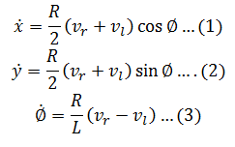
Techniques : Robot Modelling
Differential drive mobile robot
Robot Kinematic model
These are control inputs , But there are not the most intuitive variables to deal with

Slide 8
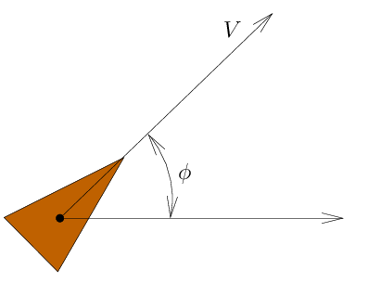
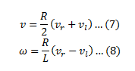
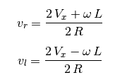
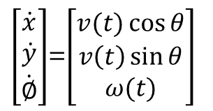
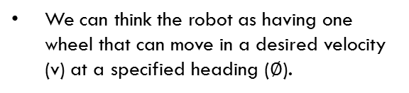
Techniques : Robot Modelling
Differential drive mobile robot
Unicycle robot model
We can think the robot as having one wheel that can move in a desired velocity (v) at a specified heading ($∅$).
$\left[\begin{matrix}\dot{x} \\ \dot{y} \\ \dot{∅}\end{matrix}\right]$=$\left[\begin{matrix}v(t)\cos{θ} \\ v\left(t\right)\sin{θ} \\ ω(t)\end{matrix}\right]$

Slide 9
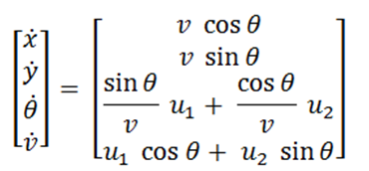
Techniques : Robot Modelling
Unicycle robot model

Slide 10
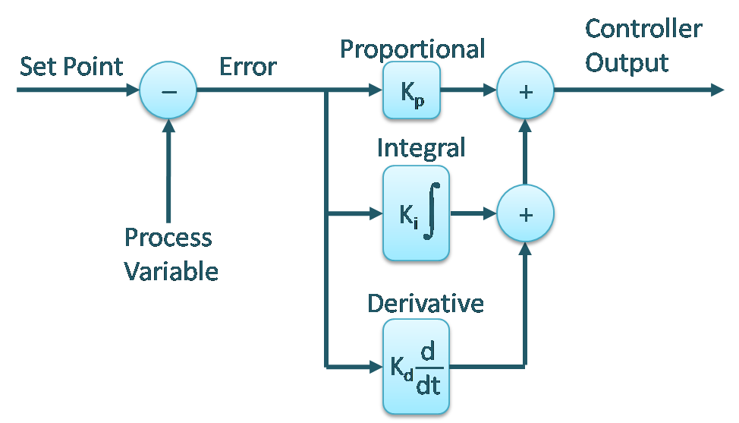
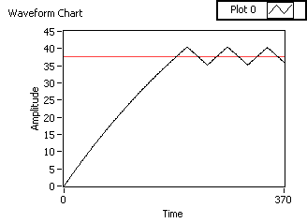
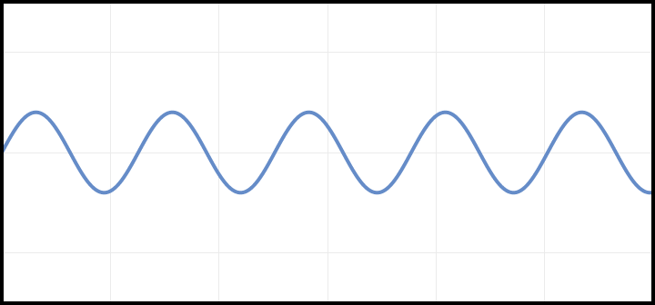
Techniques : PID controller
PID Controller
Bang-Bang controller
Reference trajectory
Oscillatory
response

Slide 11
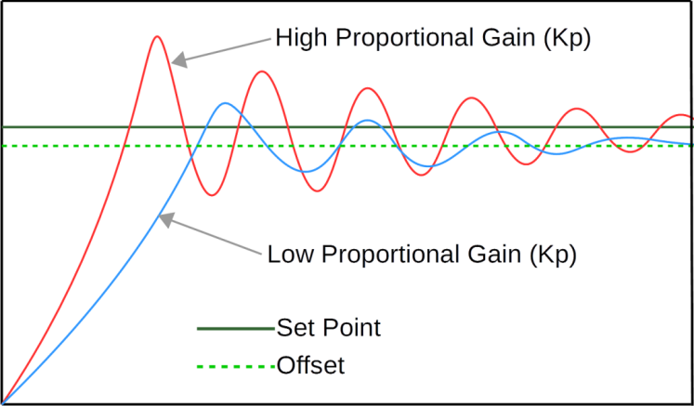
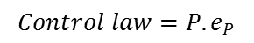
Techniques : PID controller
PID Controller
Proportional controller
Proportional control act harder the further away we are from the desired trajectory ( Compensation amount is not fixed )
$$Control law=P. e_{P}$$

Slide 12
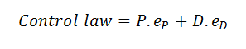
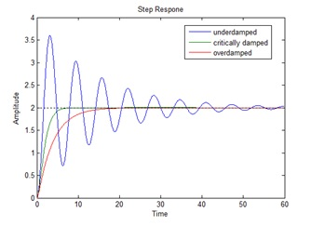
Techniques : PID controller
PID Controller
Derivative controller
An extra measurement is to look at the cross track error rate ( Derivative)
We can think that increasing the proportional gain will increase the pull that the robot feels towards the desired trajectory , increasing the derivative gain increases the resistance the robot will feel against moving too quickly towards the line

Slide 13
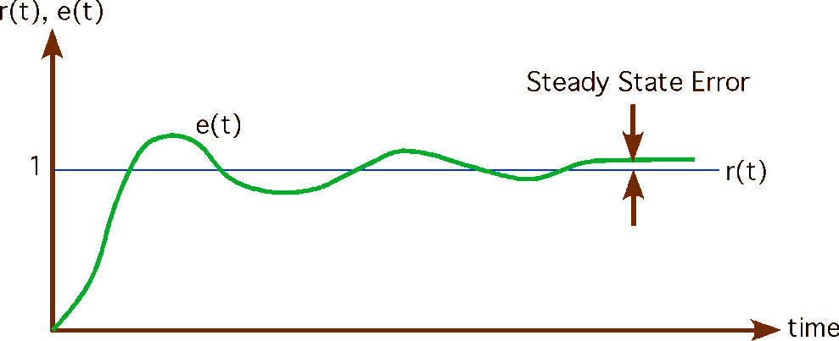
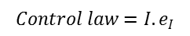
Techniques : PID controller
PID Controller
Integral controller
This third measurement sums up the cross track error to give an indication if we are spending more time on one side of the trajectory or the other ( Steady state error )
$$Control law=I. e_{I}$$

Slide 14
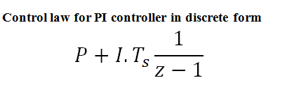
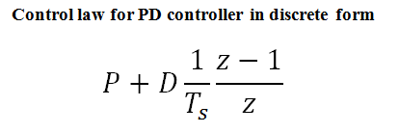
Techniques : PID controller
PI and PD controllers are implemented in MATLAB Simulink
PI Controller
PD Controller

Slide 15
Techniques : Model predictive controller (MPC)
Model predictive control encompasses a range of control methods used in SISO and MIMO processes, It was first used at Shell Oil in 1970 and now it is used in a wide variety of industries from aerospace to petrochemicals
It requires a model of the process to minimize the difference between the predicted output and the desired output and it can be used in simple and complex processes.

Slide 16
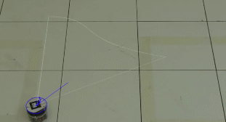
Techniques : Model predictive controller (MPC)
Example for MPC usage in Trajectory tracking

Slide 17
Techniques : Model predictive controller (MPC)
In its simplest form MPC predicts future outputs using the current inputs and outputs and future controller actions basically it uses what is happening now to predict what will happen in the future
Why MPC ?
Model predictive control is so versatile it can be used in virtually any situation but when is it typically applied
It is also superior to other controllers when the process has multiple constraints and/or nonlinear constraints

Slide 18
Techniques : Model predictive controller (MPC)
In its simplest form MPC predicts future outputs using the current inputs and outputs and future controller actions basically it uses what is happening now to predict what will happen in the future
Every MPC consist of three elements
Process Model
Objective function
Control law

Slide 19
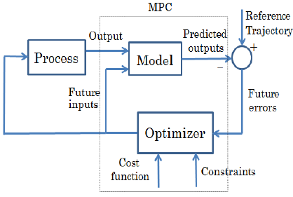
Techniques : Model predictive controller (MPC)
In its simplest form MPC predicts future outputs using the current inputs and outputs and future controller actions basically it uses what is happening now to predict what will happen in the future

Slide 20
Techniques : Model predictive controller (MPC)
In its simplest form MPC predicts future outputs using the current inputs and outputs and future controller actions basically it uses what is happening now to predict what will happen in the future
Prediction Horizon
To which extent we are predicting ?
Example 1 : Driving a car
Example 2 : Heating a house
Prediction horizon > settling time

Slide 21
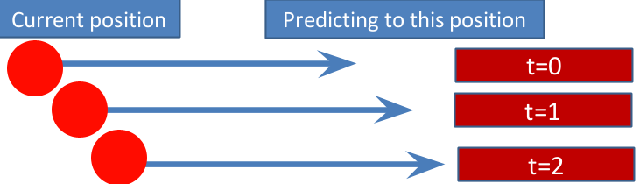
Techniques : Model predictive controller (MPC)
In its simplest form MPC predicts future outputs using the current inputs and outputs and future controller actions basically it uses what is happening now to predict what will happen in the future
Receding horizon
Receding horizon means it means that your endpoint moves away as your start point moves forward and the horizon always stays the same , In other words the actual distance that your predict is staying the same , it's just at the end point is moving

Slide 22
Techniques : Model predictive controller (MPC)
Prediction modelling in state space
Decision variables
Model parameters
Measurement

Slide 23
Techniques : Model predictive controller (MPC)
Performance index
Which response is best and why?

Slide 24
Techniques : Model predictive controller (MPC)
Performance index
Some controller uses settling time , percentage overshoot , rise time …etc for performance assessment
MPC is typically based on a precise numerical optimum
PID
MPC Parameters of control law
Settling time
Overshoot
Rise time
Settling time
Overshoot
Rise time
Analytical
relation
Analytical
relation

Slide 25
Techniques : Model predictive controller (MPC)
Example
Performance index or Cost function
or Objective function
The goal of MPC is to minimize this function . This is the sum of all the terms that have control requirements and these terms are weighted according to their significance in the process

Slide 26
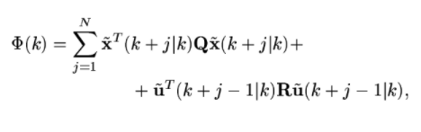
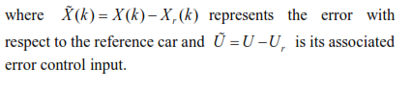
Techniques : Model predictive controller (MPC)
Performance index or Cost function
or Objective function
Cost function used for reference tracking
The goal of MPC is to minimize this function . This is the sum of all the terms that have control requirements and these terms are weighted according to their significance in the process

Slide 27
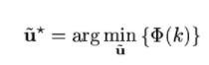
Techniques : Model predictive controller (MPC)
Control law used for reference tracking
The MPC control law is implicitly given by the first control action of the sequence of optimal control.

Slide 28
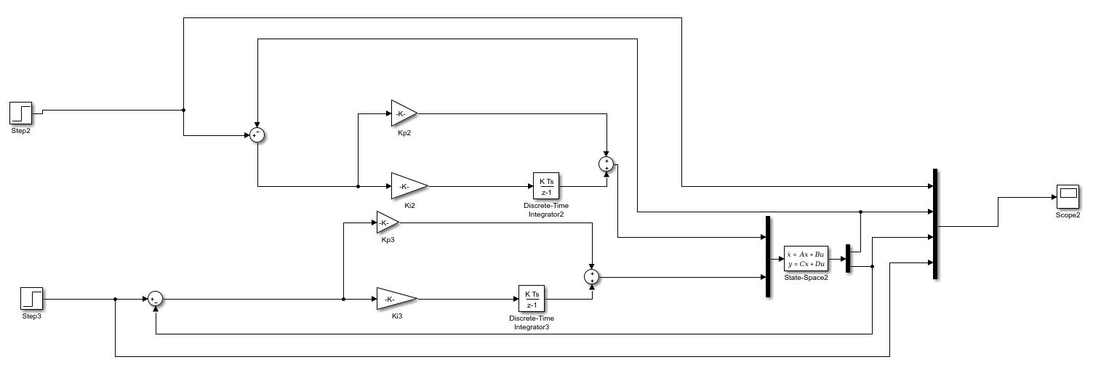
Simulations and results : PI controller
Simulation of PI controller was made in Simulink

Slide 29
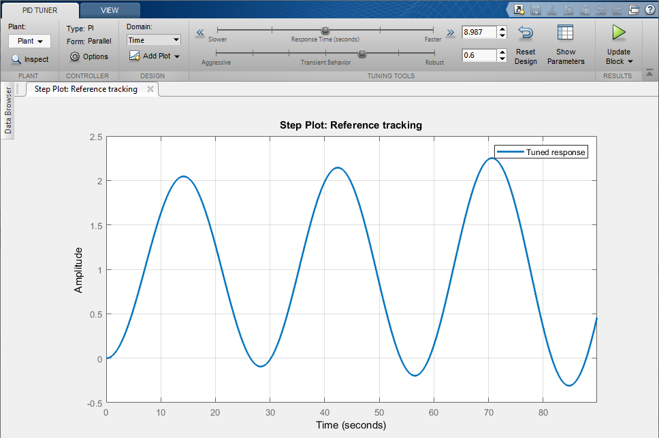
Simulations and results : PI controller ( Tuning )
Simulation of PI controller was made in Simulink
PI controller gave poor oscillatory response

Slide 30
Simulations and results : PD controller
Simulation of PI controller was made in Simulink
X axis controller
Y axis controller

Slide 31
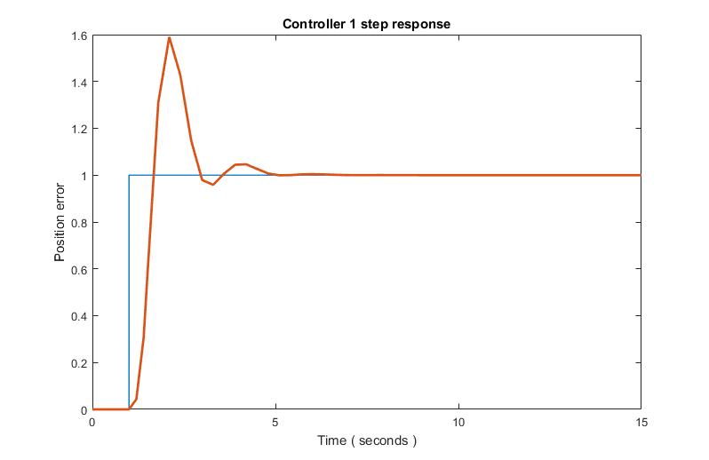
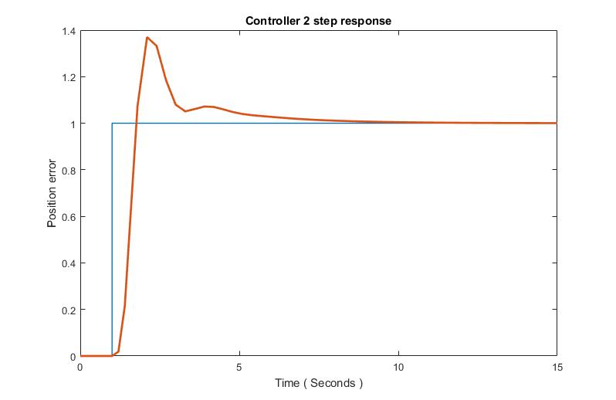
Simulations and results : PD controller ( Step response )
Simulation of PD controller was made in Simulink
Kp = 2.16 Kd = 2.15
Kp = 0.92 Kd = 2.16
RiseTime: 0.3915
SettlingTime: 4.6031
SettlingMin: 0.9589
SettlingMax: 1.5898
Overshoot: 58.9828
Peak: 1.5898
PeakTime: 2.1000
RiseTime: 0.4360
SettlingTime: 6.6434
SettlingMin: 1.0005
SettlingMax: 1.3699
Overshoot: 36.9292
Peak: 1.3699
PeakTime: 2.1000

Slide 32
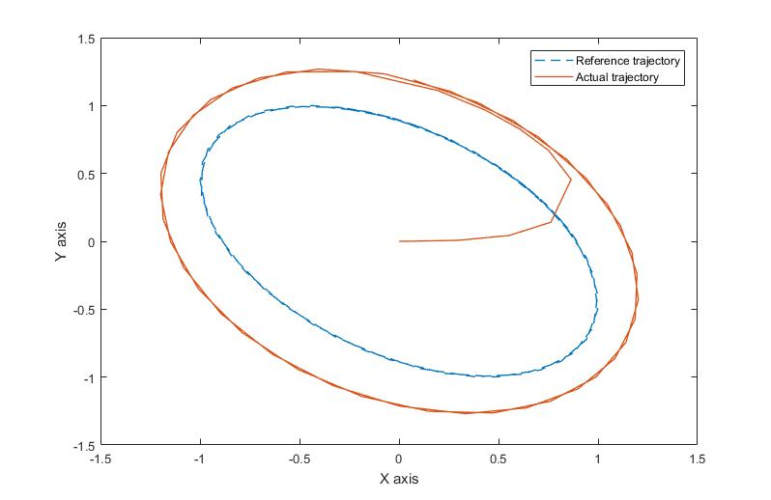
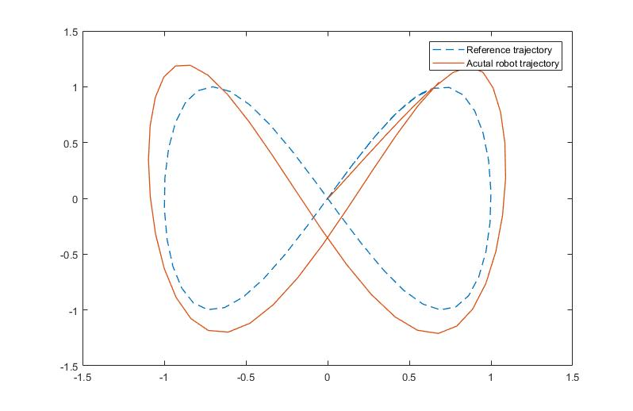
Simulations : PD controller
Trajectory tracking
Simulation of PD controller was made in Simulink

Slide 33
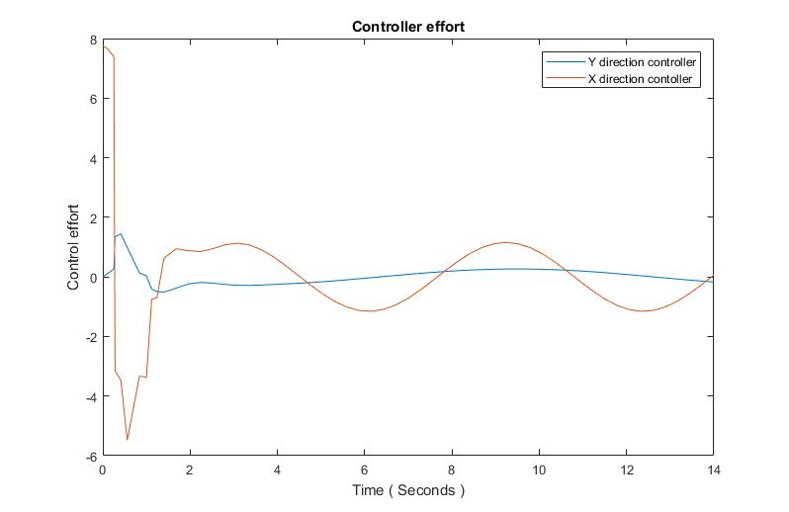
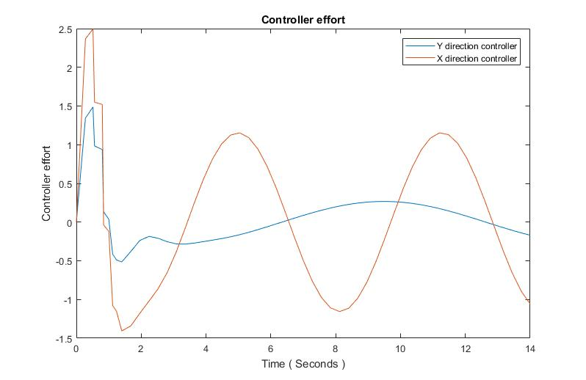
Simulations : PD controller
Controller effort
Simulation of PD controller was made in Simulink

Slide 34
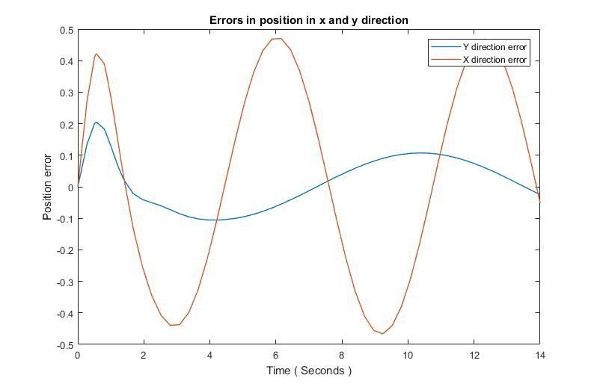
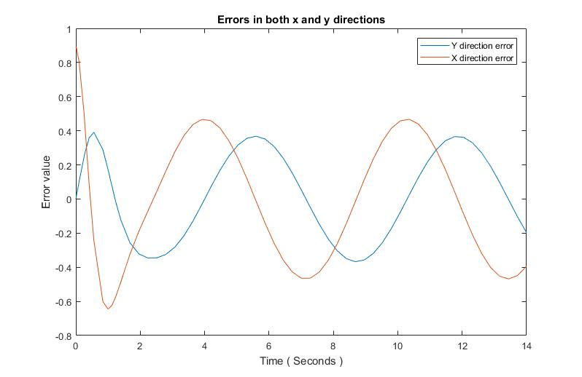
Simulations : PD controller
Position Error
Simulation of PD controller was made in Simulink

Slide 35
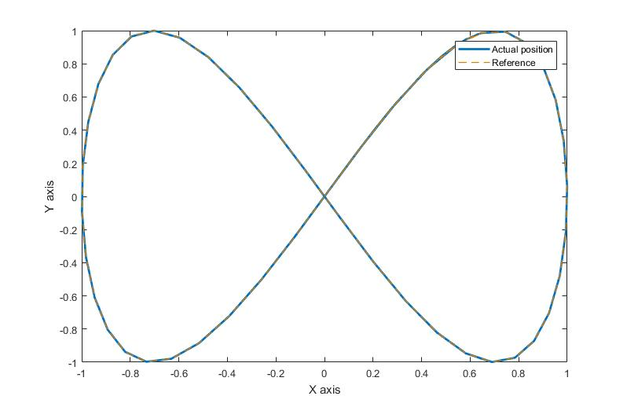
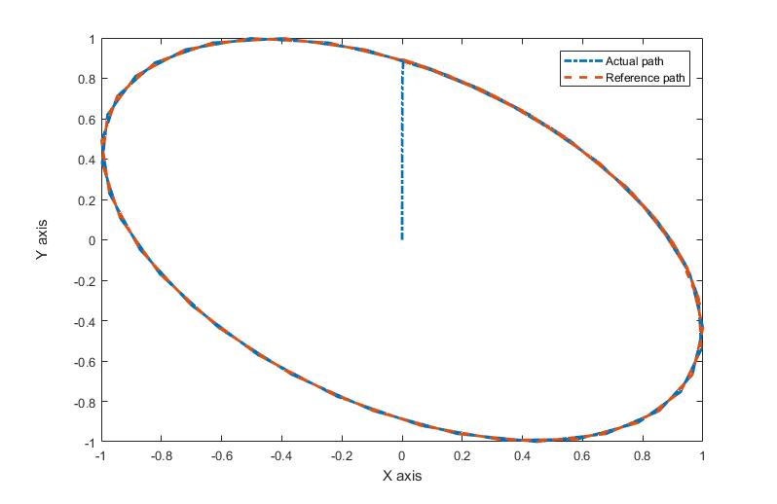
Simulations and results : MPC
Trajectory tracking
Simulation of PI controller was as m file in MATLAB

Slide 36
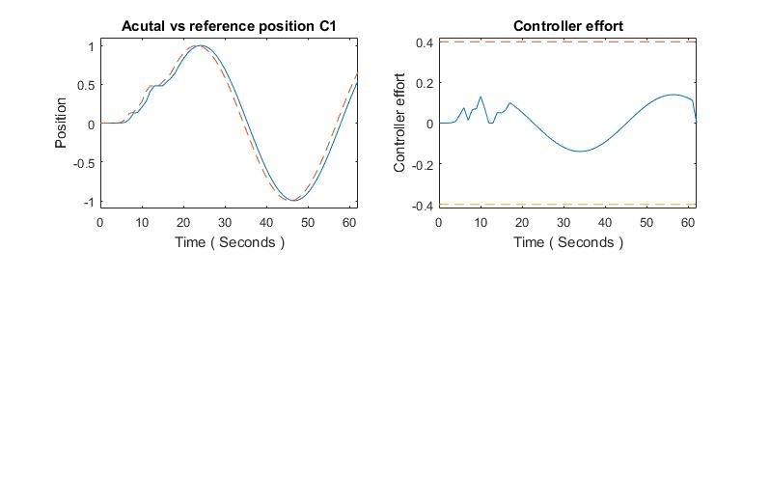
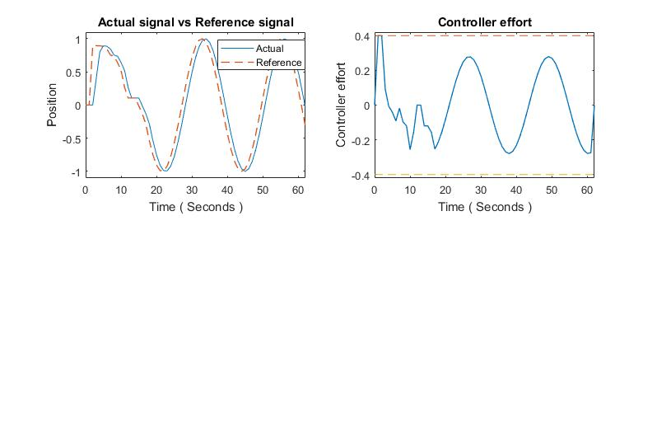
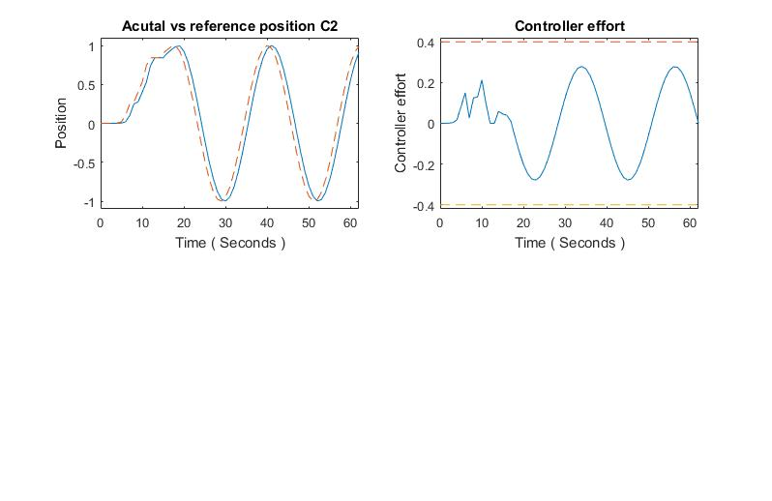
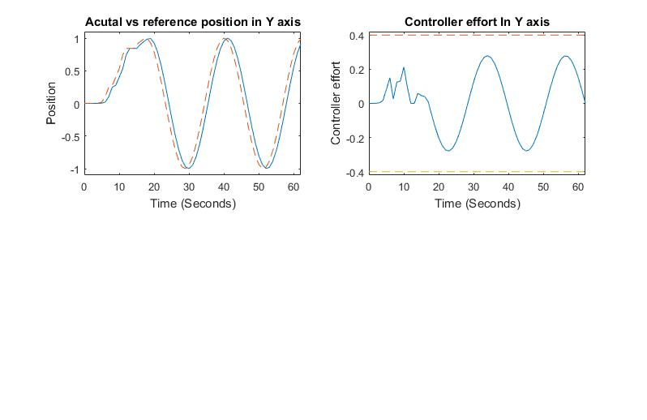
Simulations : MPC
Position Error

Slide 37
Simulations : MPC
Controller effort

Slide 38
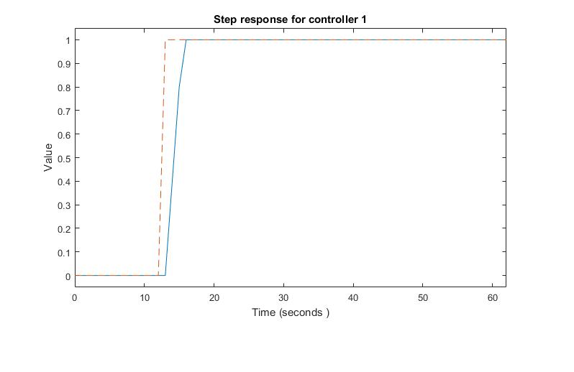
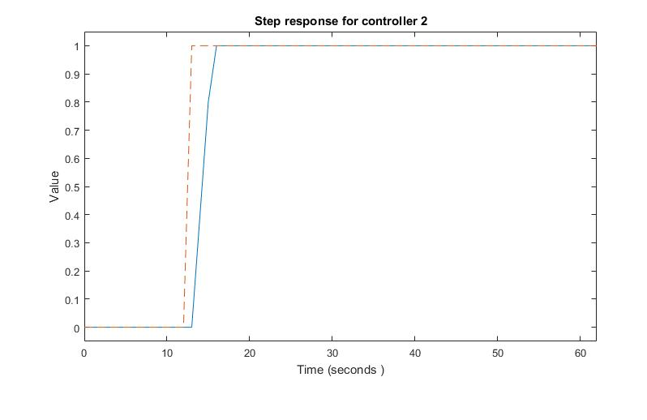
Comparison
Step response
PD controller
MPC
RiseTime: 0.3915
SettlingTime: 4.6031
SettlingMin: 0.9589
SettlingMax: 1.5898
Overshoot: 58.9828
Peak: 1.5898
Peacetime: 2.1000
RiseTime: 1.0000
SettlingTime: 1.0000
SettlingMin: 56
SettlingMax: 62
Overshoot: 0
Undershoot: 0
PeakTime: 1.0000
RiseTime: 0.4360
SettlingTime: 6.6434
SettlingMin: 1.0005
SettlingMax: 1.3699
Overshoot: 36.9292
Peak: 1.3699
PeakTime: 2.1000
RiseTime: 1.0000
SettlingTime: 1.0000
SettlingMin: 56
SettlingMax: 62
Overshoot: 0
Undershoot: 0
PeakTime: 1.0000

Slide 39
Comparison
Trajectory tracking
PD controller
MPC

Slide 40
Comparison
Trajectory tracking
PD controller
MPC

Slide 41
Comparison
Error (Figure 8)
PD controller
MPC

Slide 42
Comparison
Error (Circular path)
PD controller
MPC

Slide 43
Comparison
Controller effort (Figure 8)
PD controller
MPC

Slide 44
Comparison
Controller effort (Circular path)
PD controller
MPC

Slide 45
Discussion and challenges
Developing two controllers with different structures and use them to solve trajectory tracking problem
Studying totally new controller (MPC)

Slide 46
Conclusion
PI controller had poor performance in trajectory tracking
PD controller had a good performance in trajectory tracking
MPC controller had shown the best performance.
Comparative study helped to understand the limitations and challenges of each controller

Slide 47
Future work
Implementing the algorithms on a real robot

Slide 48
Any Questions ?

